Slide 1


Introduction to... Arduino
CS-OUTREACH
Notes:
This presentation demonstrates the new capabilities of PowerPoint and it is best viewed in Slide Show. These slides are designed to give you great ideas for the presentations you’ll create in PowerPoint 2010!
For more sample templates, click the File tab, and then on the New tab, click Sample Templates.

Slide 2
Introduction
1
Design, organize, and collaborate

Slide 3

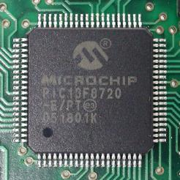
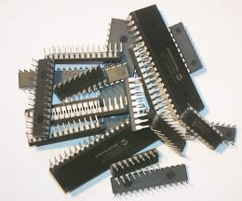
Micro-Controller
It is a micro-computer. As any computer it has internal CPU, RAM, IOs interface.
It is used for control purposes, and for data analysis.
Famous microcontroller manufacturers are MicroChip, Atmel, Intel, Analog devices, and more.

Slide 4
What is Arduino?
A microcontroller board, contains on-board power supply, USB port to communicate with PC, and an Atmel microcontroller chip.
It simplify the process of creating any control system by providing the standard board that can be programmed and connected to the system without the need to any sophisticated PCB design and implementation.
It is an open source hardware, any one can get the details of its design and modify it or make his own one himself.

Slide 5
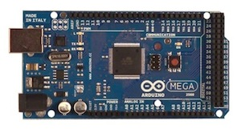
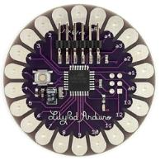
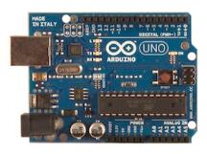
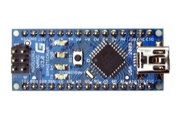
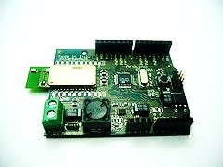
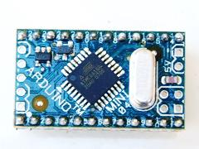
Few Arduino Boards
UNO
Mega
LilyPad
Arduino BT
Arduino Nano
Arduino Mini

Slide 6

Key sections of Arduino Uno
Digital output
~: PWM.
0,1: Serial port.
In circuit Serial programming
Atmel MicroController
USB port
Power input
Power Supply
Analog input.

Slide 7
Digital or Analog?
All physical quantities are analog.
Analog means that the quantity can take any value between its minimum value and maximum value.
Digital means that the quantity can take specific levels of values with specific offset between each other.
Ex: 1- Digital:
English alpha consists of 26 letter, there is no letter between A and B.
- Square waves are Digital.
Ex.: 2- Analog:
Temperature, can take any value[-1,12.8,25.002,… etc.].
- Sine waves are analog.
Digital and analog.

Slide 8
Arduino Coding.
2
Stylize, edit, and animate your media

Slide 9
Data types and Operators
Integer: used with integer variables with value between 2147483647 and -2147483647.
Ex: int x=1200;
Character: used with single character, represent value from -127 to 128.
Ex. char c=‘r’;
Long: Long variables are extended size variables for number storage, and store 32 bits (4 bytes), from -2,147,483,648 to 2,147,483,647.
Ex. long u=199203;
Floating-point numbers can be as large as 3.4028235E+38 and as low as -3.4028235E+38. They are stored as 32 bits (4 bytes) of information.
Ex. float num=1.291; [The same as double type]

Slide 10
Statement and Operators
Statement represents a command, it ends with ;
Ex:
int x;
x=13;
Operators are symbols that used to indicate a specific function:
- Math operators: [+,-,*,/,%,^]
- Logic operators: [==, !=, &&, ||]
- Comparison operators: [==, >, <, !=, <=, >=]
Syntax:
; Semicolon, {} curly braces, //single line comment, /*Multi-line comments*/

Slide 11
Statement and Operators
Compound Operators:
++ (increment)
-- (decrement)
+= (compound addition)
-= (compound subtraction)
*= (compound multiplication)
/= (compound division)

Slide 12
Control statements
If Conditioning:
if(condition)
{
statements-1;
…
Statement-N;
}
else if(condition2)
{
Statements;
}
Else
{statements;}

Slide 13
Control statements
Switch case:
switch (var) {
case 1:
//do something when var equals 1
break;
case 2:
//do something when var equals 2
break;
default:
// if nothing else matches, do the default
// default is optional
}

Slide 14
Loop statements
Do… while:
do{
Statements;
}
while(condition); // the statements are run at least once.
While:
While(condition)
{statements;}
for
for (int i=0; i <= val; i++){
statements;
}
Use break statement to stop the loop whenever needed.

Slide 15
Code structure
Void setup(){}
Used to indicate the initial values of system on starting.
Void loop(){}
Contains the statements that will run whenever the system is powered after setup.

Slide 16
Input and Output
Led blinking example:
Used functions:
pinMode();
digitalRead();
digitalWrite();
delay(time_ms);
other functions:
analogRead();
analogWrite();//PWM.

Slide 17

Workshop

Slide 18

LET’s BEGIN ☺
IEEE MiniaSB.

